Slide 1



Belbin Team Roles
Supporting individual and team performance
Notes:
Introduction
Purpose framing:
“Today we’re going to look at how people contribute when they work together, not just who they are individually.”
“This isn’t about changing who people are, it’s about using people more effectively to support team efficiency and performance.”
Workshop ground rules

Slide 2






BELBIN TEAM ROLES: RESEARCH
Did you know that you cannot predict a team’s results based on its members’ individual excellence or skills?
belbinnorthamerica.com
Notes:
What differentiates the Belbin methodology from other approaches is that it is evidence based.
Dr. Belbin, working within a university setting, spent 9 years studying what factors led to superior team performance. He worked with executives going through management training. He placed them in teams and had them compete in a two-day management simulation that produced actual financial results.
His research revealed that it was the dynamic aspects of teamwork that were the determining factor in team success. He also discovered the 9 team roles that, when played effectively in a team, led to them getting better results than other teams.
Dr. Belbin was able to accurately predict the rank order in which the teams would perform in these simulations. He would put his predictions about the rank order of the teams into an envelope ahead of time. And, when the simulations were completed, would compare his predictions to the actual results.
Belbin was able to predict, with over 80% accuracy, which teams would perform well in these simulations based on the balance of Team Roles present. In other words, when the nine Team Roles are thoughtfully balanced across the three role categories, teams tend to perform more effectively and more predictably.

Slide 3


WHAT IS A TEAM ROLE?
“A tendency to behave, contribute, and interrelate with others in a particular way when working in a team.”
belbinnorthamerica.com
Notes:
In Belbin, a Team Role is defined as a tendency to behave, contribute, and interrelate with others in a particular way when working in a team. It describes how you show up when collaborating with others, not your personality, job title, or technical expertise.
A Team Role is different from a Functional Role. A Functional Role refers to what a person is responsible for doing in their job, including the technical skills, knowledge, and experience required to meet job demands.
Facilitator tips
Emphasize “tendency,” not “fixed trait.”
Avoid labeling/language like “you are a…”
There are no good or bad roles.

Slide 4








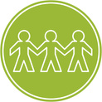


BELBIN TEAM ROLE MODEL
Does NOT mean you need nine people on the team!
Each individual likely has about three:
LEAST PREFERRED
What I wish someone else would do
MANAGEABLE
What I do if needed
NATURAL or PREFERRED
What I like to do
belbinnorthamerica.com
Notes:
Every individual exhibits the attributes of the nine Team Roles in different ways. How well we can fulfill those roles determines whether they are preferred, manageable or least preferred:
Preferred roles: are the Team Roles that you are best at. These roles will tend to come naturally to you.
Manageable roles: may not come naturally to you, but they are roles that you can stretch into with support from other team members.
Least preferred roles: represent the contributions that you may struggle with.
If Team Role contributions are properly operationalized in a team, the team can be predicted to have better results.
This doesn't mean a team needs nine people, as everyone is a combination of roles - most people are good at two or three. But each role should be represented within the team. Some roles will be more or less important at a given time or for certain tasks the team is facing. Who plays each role may also evolve and change over time.
When Team Role contributions are understood and intentionally used:
Teams are better able to manage gaps and overlaps.
Collaboration improves.
Results become more predictable.

Slide 5

FACTORS DETERMINING INDIVIDUAL BEHAVIOR IN TEAMS
MENTAL
ABILITIES
PERSONALITY
ROLE
LEARNING
VALUES &
MOTIVATIONS
EXTERNAL
INFLUENCES
EXPERIENCE
BEHAVIOR
belbinnorthamerica.com
Notes:
It is important to know that your Belbin assessment is not a personality profile. Personality assessments, such as MBTI, DISC, or the Big Five, measure underlying traits, preferences, or cognitive styles. They help explain who we are and how we tend to think, and they can be useful for self-awareness and individual development.
Belbin focuses on observable behavior in a team context. Behavioral assessments look at how people actually behave when contributing to work, how they interact with others in meetings, projects, and decision-making. Because behavior is flexible and context-dependent, it can be adapted and managed.
This is why Belbin is especially useful for teams. It helps identify practical ways to improve how work gets done, not just how people feel or think.
If Belbin focuses on behavior, the next question is what actually shapes how people behave in teams.
Several factors influence behavior:
Personality is relatively stable over time and includes traits such as introversion or extraversion and openness to new ideas. It influences behavior, but it does not fully determine it.
Mental ability is not just academic intelligence. It includes how abstract or big-picture someone tends to think and affects how people approach problems and ideas in teams.
Values and motivations reflect what matters to someone personally and professionally, such as achievement, security, contribution, or influence. These strongly shape how and why people engage in teamwork.
Experience includes both work experience and life experience. Past successes and failures influence current behavior.
External influences include team size, role, level of responsibility, organizational culture, and broader factors such as change, uncertainty, or pressure.
Role learning refers to awareness of individual and team strengths and weaknesses, and the ability to consciously draw on certain behaviors when needed. This is where Belbin becomes developmental rather than fixed.

Slide 6








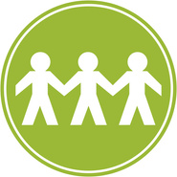



NINE ROLES GROUPED INTO THREE CATEGORIES
THINKING ORIENTED ROLES
ACTION ORIENTED ROLES
PEOPLE ORIENTED ROLES
PLANT
SHAPER
COORDINATOR
SPECIALIST
IMPLEMENTER
TEAMWORKER
MONITOR EVALUATOR
COMPLETER FINISHER
RESOURCE INVESTIGATOR
belbinnorthamerica.com
Notes:
The nine Belbin Team Roles are grouped into three broad categories.
They are not rankings, and no category is more important than another.
Effective teams typically need contributions from all three.
1) Thinking-Oriented Roles
These roles focus on ideas, analysis, and judgment.
They help teams think things through before acting.
The three Thinking-Oriented roles are:
Plant — generates new ideas and creative solutions
Specialist — brings in-depth knowledge or expertise
Monitor Evaluator — analyzes options and offers objective judgment
2) Action-Oriented Roles
These roles focus on turning ideas into outcomes.
They help teams move from discussion to execution.
The three Action-Oriented roles are:
Shaper — drives momentum and challenges the team to move forward
Implementer — turns plans into practical action
Completer Finisher — ensures work is finished thoroughly and on time
3) People-Oriented Roles
These roles focus on relationships and collaboration.
They help the team work well together and connect with others.
The three People-Oriented roles are:
Coordinator — clarifies goals and brings people together
Teamworker — supports collaboration and team cohesion
Resource Investigator — explores opportunities and builds external connections

Slide 7
THE NINE TEAM ROLES
TEAM ROLE CONTRIBUTION
ALLOWABLE WEAKNESS
PLANT
PL
Generates ideas & solves hard problems.
Preoccupied.
MONITOR EVALUATOR
ME
Sees all options and judges accurately.
Overly critical. Slow moving.
THINKING
SPECIALIST
SP
Provides rare knowledge and skills.
Narrow focus.
SHAPER
SH
Has drive to overcome obstacles.
May display impatience.
IMPLEMENTER
IMP
Turns ideas into actions and organizes tasks.
Possibly inflexible.
ACTION
COMPLETER FINISHER
CF
Finds errors. Polishes and perfects.
Reluctant to delegate.
COORDINATOR
CO
Clarifies goals. Delegates effectively.
May over-delegate.
PEOPLE
TEAM WORKER
TW
Listens and averts friction.
Avoids confrontation.
RESOURCE INVESTIGATOR
RI
Explores opportunities, develops contacts.
Over-optimistic.
Notes:
This slide shows all nine Belbin Team Roles, each with its primary contribution to the team.
Each Team Role brings something valuable and necessary to team performance.
There are no “good” or “bad” roles.
The value comes from how roles are understood and used together.
Every Team Role also comes with what Belbin calls allowable weaknesses.
These are not flaws or deficiencies.
They are the trade-offs that tend to accompany a particular strength.
An allowable weakness is essentially the price the team is willing to pay for a valuable contribution.
For example:
Someone strong in the Resource Investigator role may bring energy, enthusiasm, and external connections.
The trade-off may be being overly optimistic about timelines or losing interest once the initial excitement fades.
The key point is:
Strengths and allowable weaknesses travel together.
The goal is not to remove weaknesses, but to manage them within the team.

Slide 8



USING BELBIN INSIGHTS FOR
PERSONAL EFFECTIVENESS
Notes:
We will now walk through your Belbin report together, page by page.
Facilitator tips
Keep the focus on the sample report, not individual data.
This report highlights patterns of contribution, not fixed traits.
It is a starting point for reflection and discussion.

Slide 9
TEAM ROLES KEY CONCEPTS - INDIVIDUAL
Play to your strengths.
  Focus on what you do best
  Understand and excel in your natural, preferred roles
  Manage your least-preferred roles
belbinnorthamerica.com
Notes:
At the individual level, the big-picture goal of Belbin is simple: play to your strengths.
Belbin encourages people to:
Understand their strongest Team Role contributions.
Use those strengths intentionally in team situations.
Avoid trying to be everything to everyone.
This is not about fixing weaknesses:
It’s about recognizing where you add the most value.
And understanding which contributions are better supported by others.
The report helps make this visible by showing:
Where your strongest contributions tend to sit.
How those strengths show up when working with others.
In the next few pages, we’ll look at how to find your strengths in the report and what to pay attention to.

Slide 10
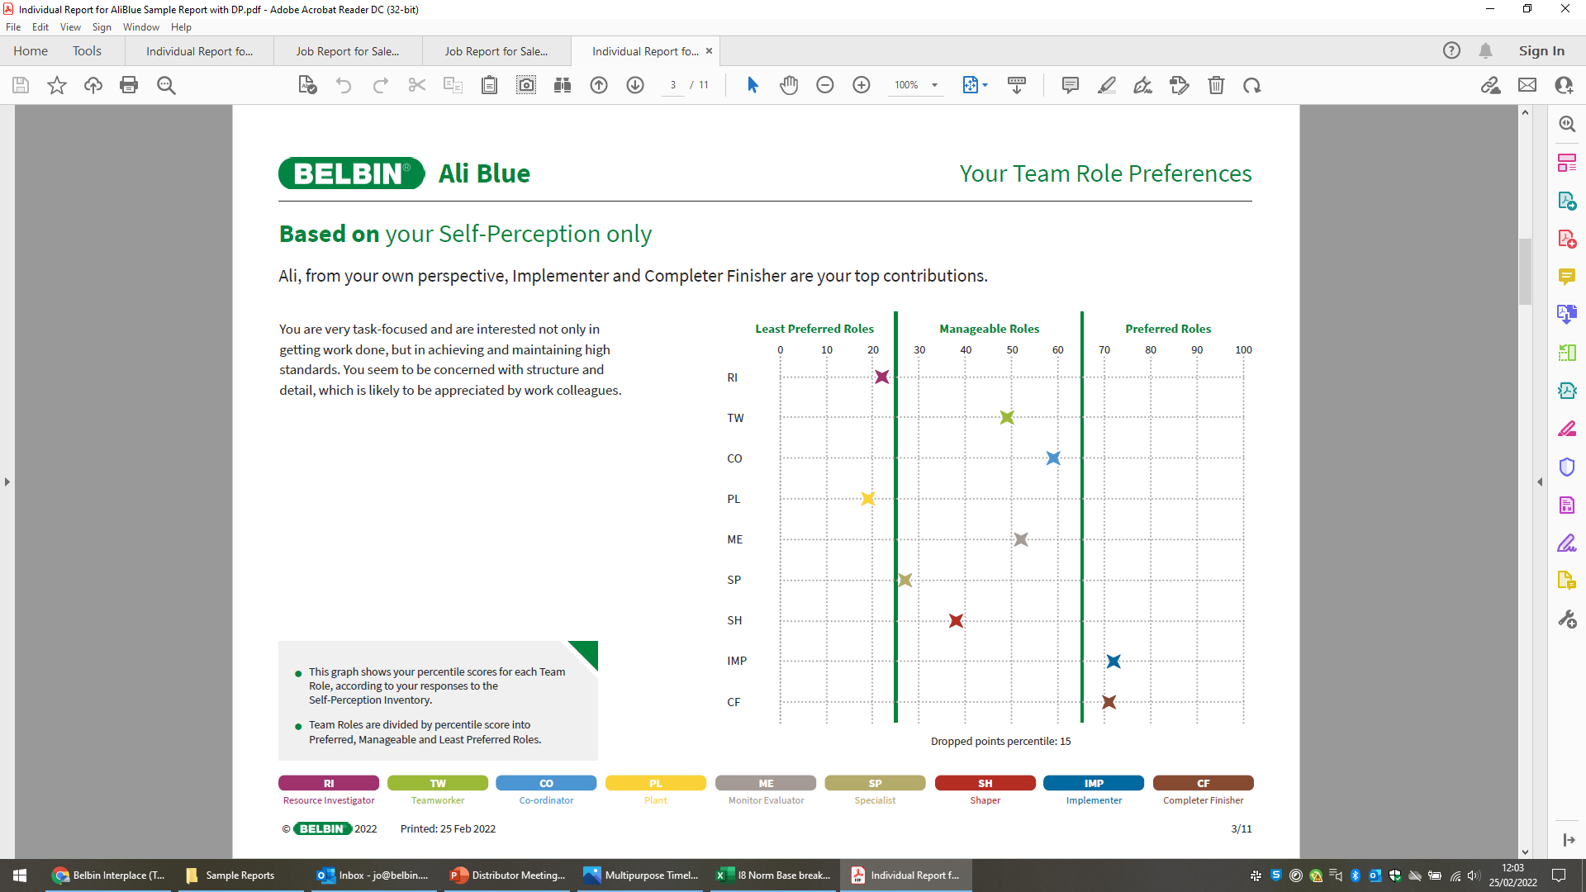
YOUR TEAM ROLE PREFERENCES
belbinnorthamerica.com
Notes:
This page reflects self-perception only.
It shows how strongly you see your own contribution across the nine Team Roles.
At this stage, no observer feedback is included.
The roles are ranked from highest to lowest based on your self-ratings. As discussed:
Preferred roles tend to come most naturally and feel energizing.
Manageable roles are roles you can step into when needed, usually with some conscious effort.
Least preferred roles are roles you are less inclined to play and may prefer to delegate.
This page helps identify where you believe your strengths lie.
To play to your strengths:
You ideally want to spend more time working in your preferred roles.
And be thoughtful about how often you rely on your manageable or least preferred roles.
Facilitator tips
This is one perspective, not the full picture.

Slide 11
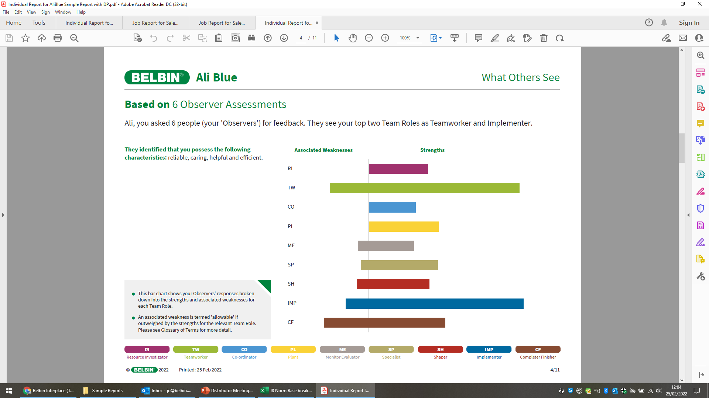
OBSERVED TEAM ROLE
STRENGTHS & WEAKNESSES
belbinnorthamerica.com
Notes:
This page shows observer feedback — how others experience your contribution when working with you.
For each Team Role:
Strengths appear to the right of the vertical line.
Weaknesses appear to the left of the vertical line.
The weaknesses shown here are allowable weaknesses as long as:
The strengths outweigh the weaknesses for that role.
Remember, allowable weaknesses are:
The natural trade-offs that come with a particular contribution.
Generally acceptable to the team because of the value that role brings.
In some cases, you may see disallowable weaknesses: when the bar on the left (weaknesses) is larger than the bar on the right (strengths) for a Team Role.
This is not a judgment.
It’s a signal to pause and reflect.
Disallowable weaknesses suggest that:
The behavior may be hindering the team more than helping in that specific role.
This is an opportunity for awareness and adjustment, not blame.

Slide 12
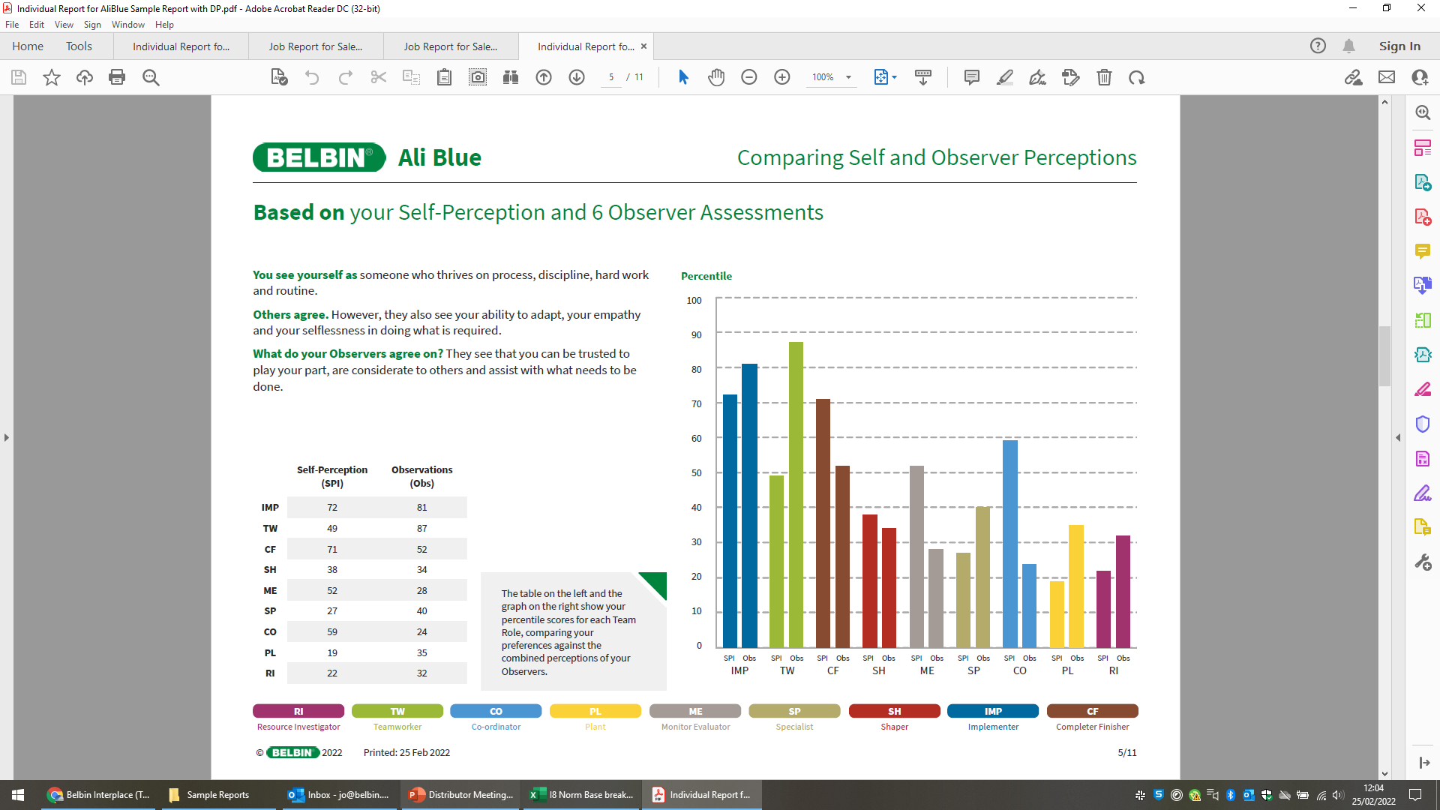
IMPORTANCE OF COHERENCE
belbinnorthamerica.com
Notes:
This page looks at coherence — the alignment between how you see yourself and how others experience your contribution.
It compares:
Self-perception, and
Observer feedback across the Team Roles.
Gaps on this page are very common.
Most people see several gaps, especially on their first Belbin report.
Gaps are normal and expected, not a problem.
What we are interested in are the larger gaps.
These often point to hidden strengths or blind spots.
They can highlight where impact differs from intention.
Coherence is not about being “right” or “wrong.”
It’s about awareness.
Increased awareness gives teams more choice in how they work together.
Facilitator tips
If someone asks, “Which is correct?” respond with “both perspectives matter — what’s important is the difference.”

Slide 13

COMPARING SELF & OBSERVER PERCEPTIONS
Look for big differences (~35 points or more)
between self-perception and observer ratings.
belbinnorthamerica.com
Notes:
This page highlights larger gaps between self-perception and observer feedback.
When you see a gap of 35 points or more, it indicates a meaningful difference between:
How you see your contribution in a role, and
How others experience that contribution.
There are two types of gaps to look for
Type 1: Hidden Strengths
A hidden strength appears when:
Observers rate a role more strongly than you rate yourself.
Type 2: Blind Spots
A blind spot appears when:
You rate yourself more strongly in a role than your observers do.
Facilitator tips
Normalize both types of gaps — everyone has them.
Encourage curiosity: “what might the team be seeing that you’re not fully aware of yet?”

Slide 14

A FERRARI IN MY GARAGE?
Hidden strengths - strengths that people don’t recognize in themselves - are potential assets that are going to waste.
belbinnorthamerica.com
Notes:
If you have a hidden strength, it raises an important question: “is it possible you have a Ferrari in your garage?”
A hidden strength suggests
You may be contributing more in that role than you realize.
The team is benefiting from a strength that you may be underusing or undervaluing.
For example: in the Teamworker (TW) role shown, observers may see stronger collaboration or support than the individual recognizes.
Many people undervalue what comes most easily to them.
Because it feels natural, it may not register as a “strength.”
Yet that contribution can be high-impact for the team.
This is where Belbin becomes developmental:
Hidden strengths are opportunities to be more intentional.
Using them more deliberately can increase your impact without extra effort.

Slide 15
WHAT ABOUT THE OTHER DIFFERENCE?
belbinnorthamerica.com
Notes:
The other type of difference appears when you rate a role more strongly than your observers do.
This suggests:
Your intention in that role may not always match your impact.
The contribution may not be as visible or helpful to others as expected.
This can happen for many reasonable reasons, for example:
You may have answered the self-perception questionnaire aspirationally — based on how you would like to contribute, rather than how you are currently contributing.
You may not have had many opportunities to play this role in your current work context.
You may contribute in this role behind the scenes, so others don’t always see it.
This kind of difference does not mean the role is unimportant or unavailable to you.
If this role is important to you:
You may need to be more intentional about creating opportunities to use it.
And more explicit about signaling your preferences to the team, so others know how you want to contribute.

Slide 16
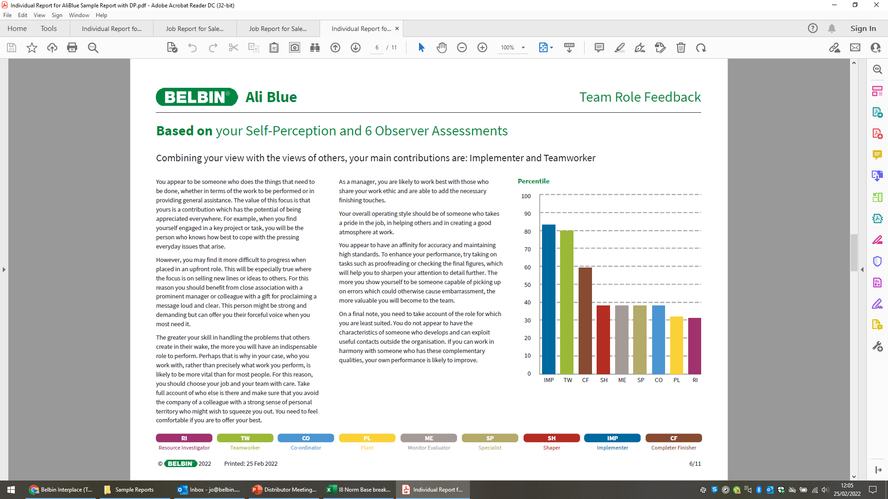
TEAM ROLE OVERVIEW
NATURAL OR PREFERRED ROLES
MANAGEABLE ROLES
LEAST PREFERRED ROLES
belbinnorthamerica.com
Notes:
This page shows the overall picture of your Team Roles.
It combines self-perception and observer feedback into one view.
The scores are grouped into three broad ranges:
Preferred (Natural) Roles — scores above 65.
These roles tend to feel most comfortable and energizing.
Manageable Roles — scores between 25 and 65.
Roles you can step into when needed, often with some conscious effort.
Least Preferred Roles — scores below 25.
Roles that tend to be draining or less effective for you.
This overview helps clarify:
Where you add the most value most naturally.
Where you may need support from others.
To use this insight well:
Play to your strengths whenever possible.
Find ways to make your least preferred roles less relevant.
Often this happens by partnering with others who have those roles as preferred contributions.

Slide 17
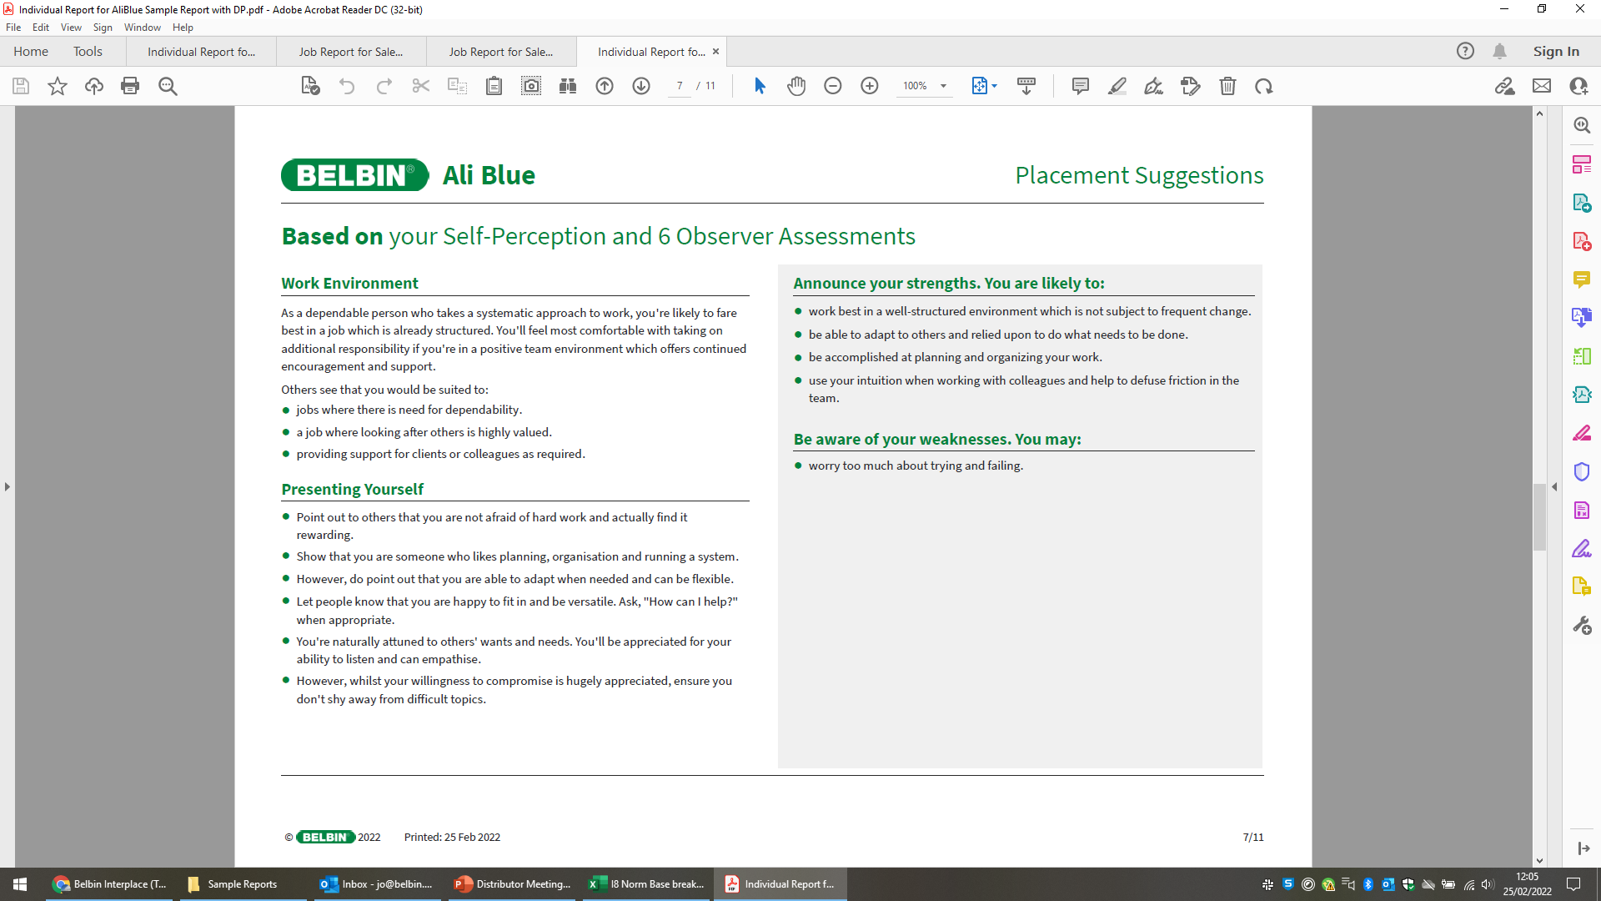
TEAM ROLE FEEDBACK
belbinnorthamerica.com
Notes:
This page provides role-specific feedback and guidance based on your results.
The most important part of this page is not the wording itself, but what it prompts you to think about:
How can you play more intentionally to your strengths?
Where might you adjust how you contribute to better support the team?
This page is a resource:
To help you reflect on your contribution.
To support personal action planning over time.
Facilitator tips
You don’t need to work through this in detail during the session. It’s designed to be revisited after the session.

Slide 18
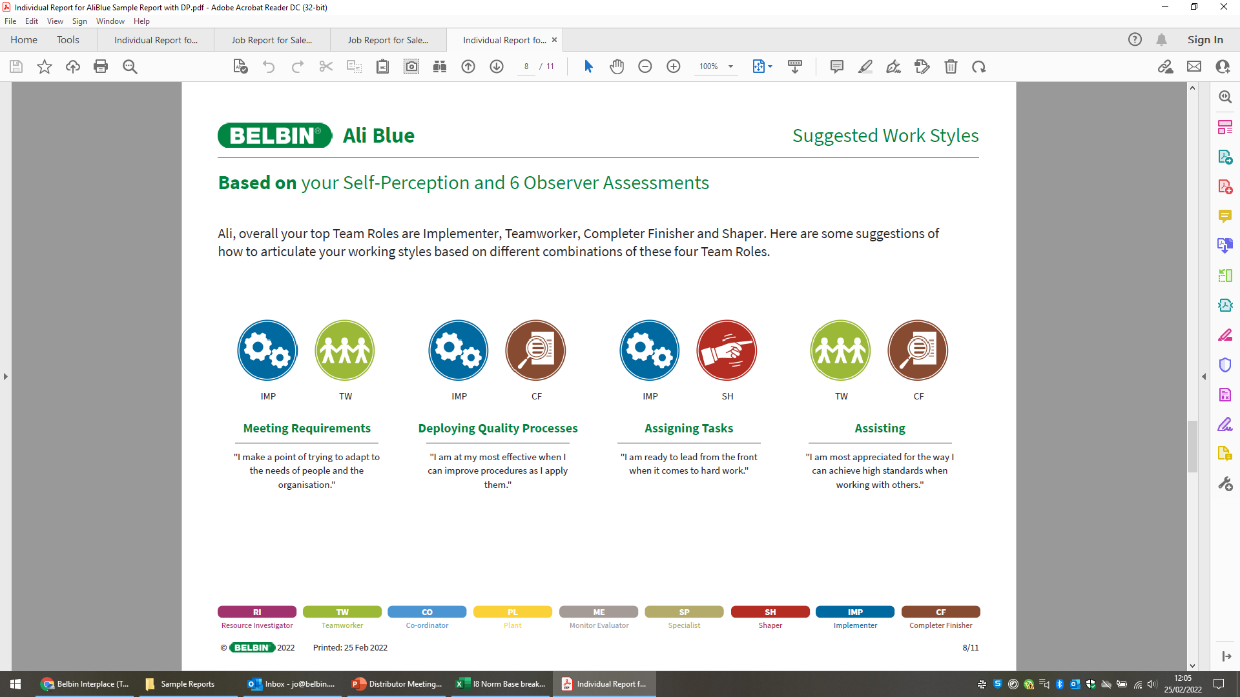
SUGGESTED WORK STYLES
belbinnorthamerica.com
Notes:
This page translates Team Roles into work styles. You can think of these as your superpowers when working with others.
Instead of looking at roles in isolation, this page looks at what happens when strengths are combined.
For example:
A combination like Implementer + Teamworker often shows up as a strong ability to meet requirements while keeping people aligned.
The value comes from how roles work together, not from a single role alone.
These work style combinations are drawn from your top four Team Roles. Typically shown as pairings such as:
1 + 2
1 + 3
1 + 4
2 + 3
Together, they give insight into:
How you prefer to contribute.
How you can best communicate your working style to others.
Where your impact is strongest when collaborating.

Slide 19
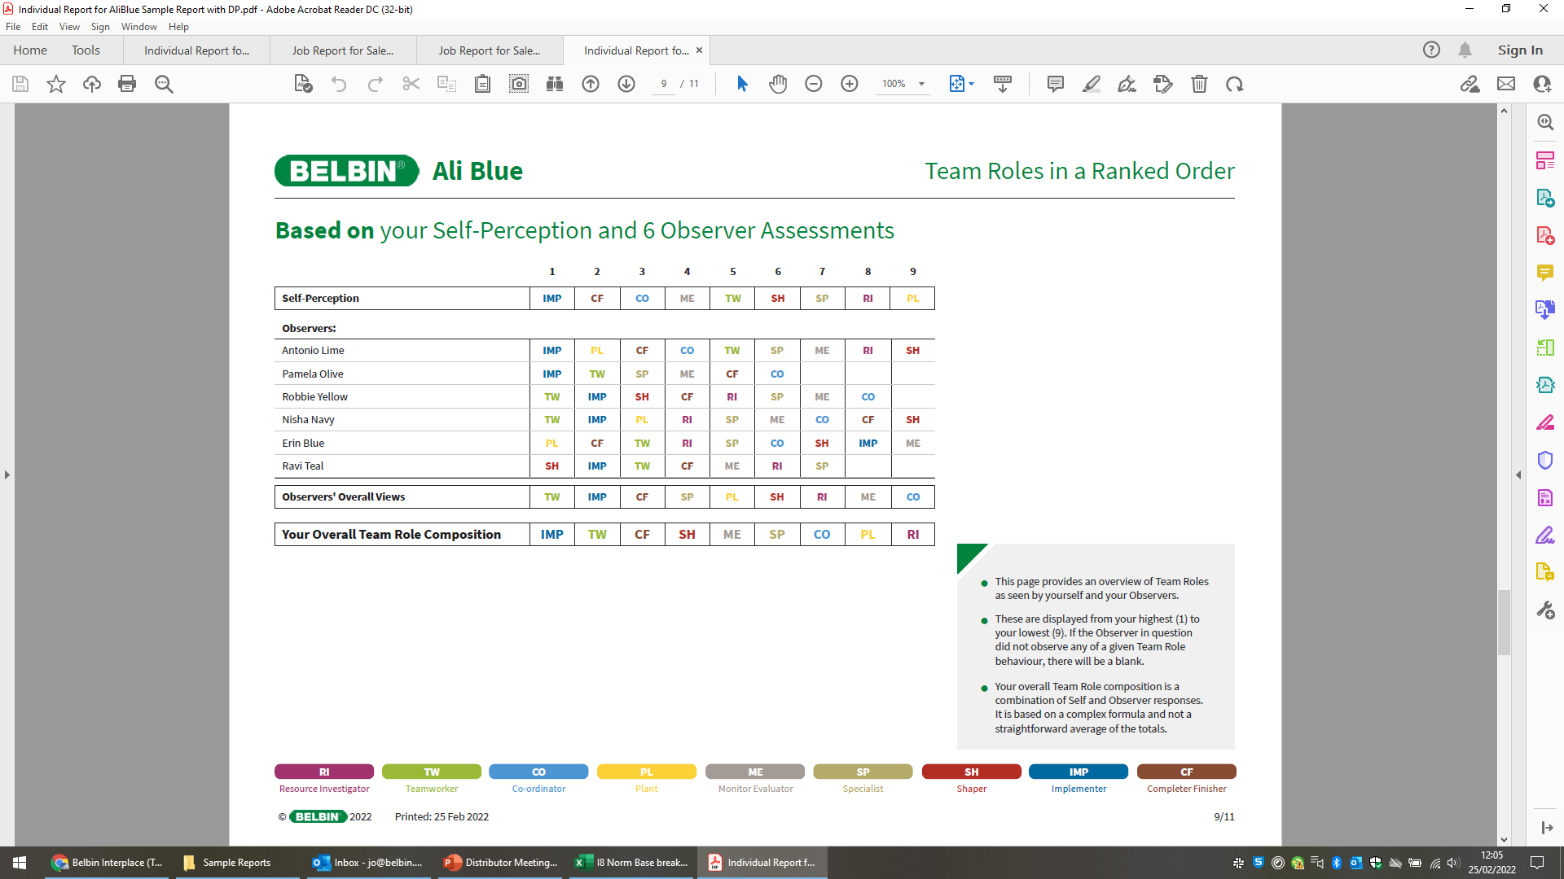
ANALYSIS OF YOUR TEAM ROLE COMPOSITION
The overall rank order on the bottom line represents the combination of the
Self-Perception and the total of the Observers’ input.
belbinnorthamerica.com
Notes:
This summary page pulls together all the individual report data in one place.
Across the top, you’ll see the nine Team Roles, numbered from 1 to 9. These numbers show how you are currently expressing your time and energy across the roles:
1 represents your strongest or most dominant contribution.
9 represents your least expressed contribution.
Everyone has all nine roles available to them, but no one can express all roles equally or at the same time.
The first line shows your self-perception. For example, this individual sees themselves as strongest in Implementer (IMP) and Completer Finisher (CF), and weakest in Plant (PL).
Below that, you’ll see the rankings from each observer. This shows how different people experience your contribution.
The line labeled Observers’ Overall Views aggregates all observer feedback into a single perspective.
If a role does not appear it means that neither you nor your observer saw any observable behavior — strength or weakness — associated with that role in the current context.
At the bottom, you’ll see Your Overall Team Role Composition.
This line combines self-perception and observer input.
It is based on a weighted calculation — roughly two-thirds observer feedback and one-third self-perception.
This overall line is the one we will use shortly in the Team Mapping exercise.

Slide 20

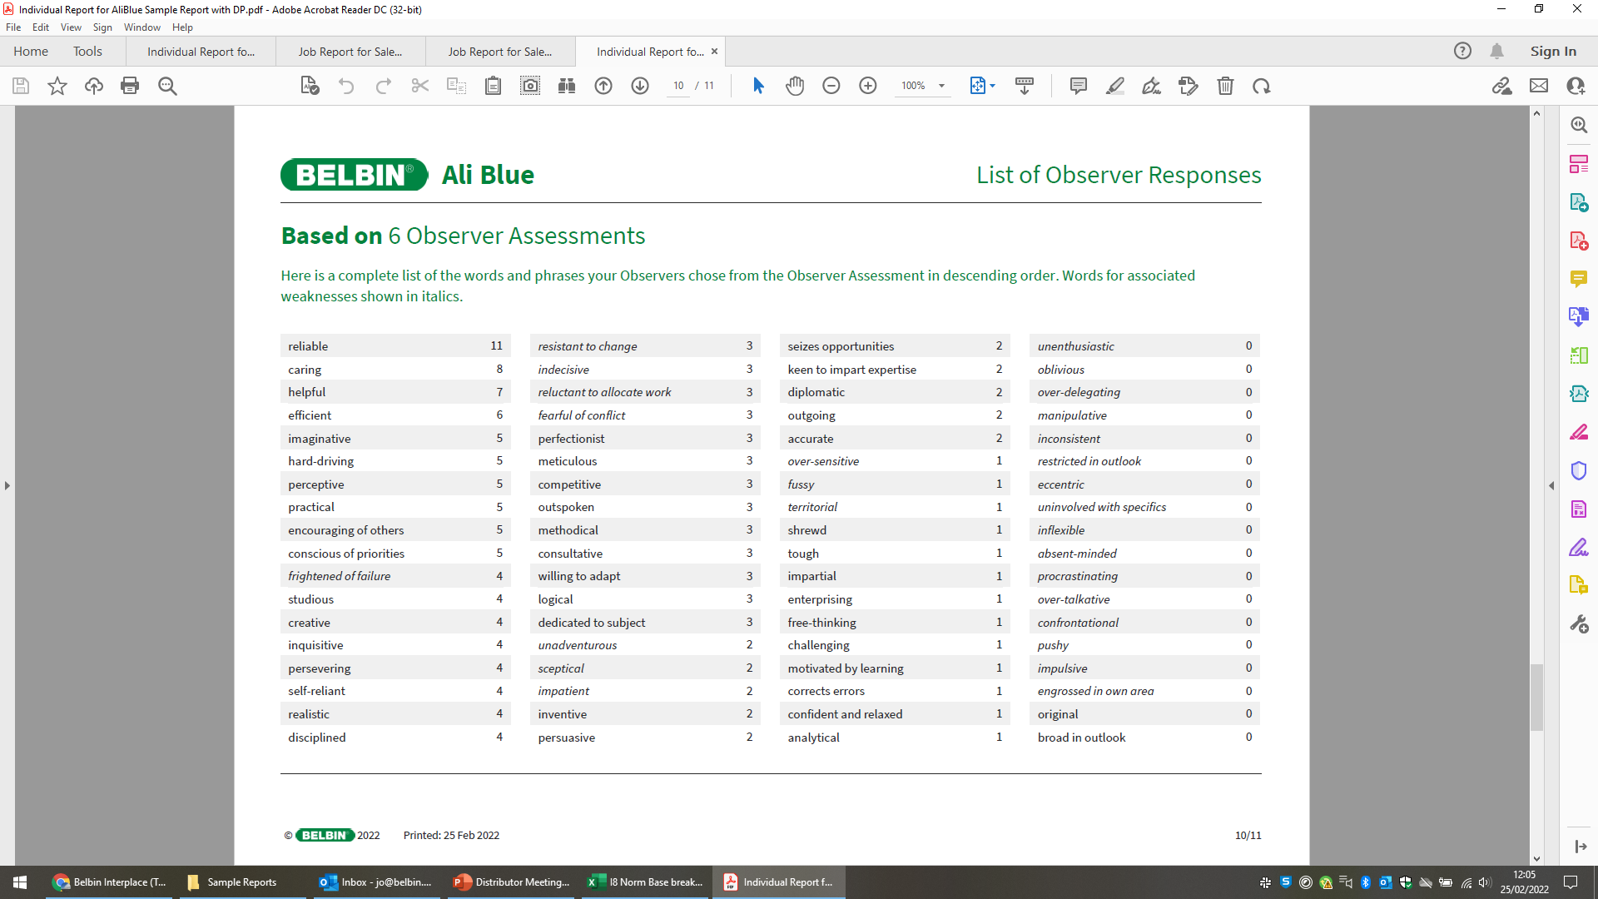
OBSERVER RESPONSES
Maximum score =
2 x number of observers
belbinnorthamerica.com
Notes:
This page shows the raw observer data behind your report.
Observers were presented with a list of specific behaviors. For each behavior:
An observer gave 1 point if they saw that behavior.
2 points if they saw that behavior very strongly or consistently.
The maximum possible score for any Team Role is: 2 × the number of observers.
For example, with 6 observers, the maximum score would be 12.
A helpful place to start is the top five behaviors listed.
You can think of these as part of your personal brand at work.
These are the behaviors others most consistently experience from you.
Also look at the highest weakness behavior:
These are shown in italics.
They often indicate where impact might be mixed or situational.
At the bottom of the list:
A score of 0 means no observer saw that behavior in you.
Scores of 1 are often best treated as noise in the data.
One isolated observation is rarely meaningful on its own.
This page can be a powerful starting point for follow-up conversations:
Asking trusted colleagues how specific behaviors help or hinder the team.
Using feedback to make small, targeted adjustments.

Slide 21
USING BELBIN
INSIGHTS FOR
TEAM EFFECTIVENESS
Team Collaboration Mapping (TCM)
Notes:
Up to now, we’ve been focused on individual insight: understanding personal strengths, preferences, and impact.
The real power of Belbin comes when we step back and look at the team as a system.
Teams are made up of individuals:
Each with a different mix of Team Role strengths and weaknesses.
What matters is how those contributions combine.
This is where we use Team Collaboration Mapping (TCM):
TCM helps make the collective pattern of contribution visible.
It shows where the team is strong, where there may be gaps, and where roles may be over- or under-represented.
The purpose of TCM is not diagnosis for its own sake.
It’s to support better collaboration, clearer expectations, and more effective ways of working together.
We’ll use the overall Team Role composition from each individual’s report as the input for this exercise.
Facilitator tips
This is often a mental shift for participants.
Reinforce that the focus is now on the team, not individuals.
If the group asks, “What does a good map look like?” respond with: “it depends on the work the team is trying to do.”

Slide 22
TEAMS ARE MADE UP OF INDIVIDUALS…
Each with their own mix of Team Role strengths and weaknesses
WHAT CAN HAPPEN WHEN A TEAM COMES TOGETHER?
belbinnorthamerica.com
Notes:
Remember, every team is made up of individuals, each with their own mix of:
Team Role strengths
Manageable roles
Least preferred roles
When individuals come together, their contributions interact:
Some roles may be reinforced.
Others may be missing or underrepresented.
Some may be overused without support.
Team effectiveness is not about everyone being good at everything, or everyone having the same strengths.
It’s about:
Understanding what the team has available.
Being intentional about how those contributions are used.
Team Collaboration Mapping helps us move from: “who am I?” to “what does this team need to succeed?”

Slide 23
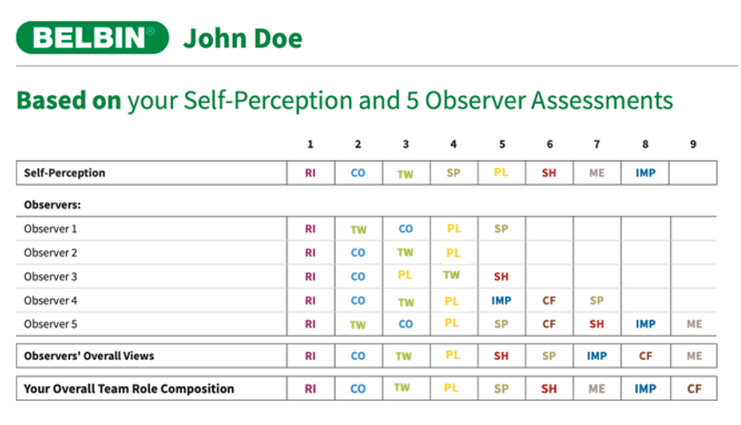
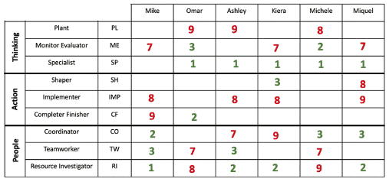
CREATE YOUR TEAM MAP
Mike’s Individual Belbin Report
Write 1, 2, and 3 by the appropriate TOP THREE roles in green
Write 7, 8 and 9 by the appropriate BOTTOM THREE roles in red
belbinnorthamerica.com
Notes:
Let’s come together to create our Team Map by gathering our “Overall Team Role Composition” from our individual reports
Facilitator tips
Have this chart already created up in the room on a white board
Everything should be filled in EXCEPT the numbers as participants will vocalize this themselves one by one
I.e. Mike will advise his #1 role is RI and put a green there in his column, #2 TW, #3 CO
He will then do his bottom three roles (ME, IMP, CF) in red as 7, 8 and 9

Slide 24
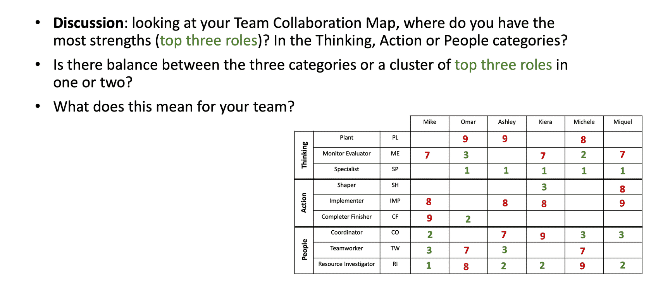
STEP 1: REVIEW THINKING, ACTION, AND PEOPLE CATEGORIES
belbinnorthamerica.com
Notes:
Now that the Team Collaboration Map is complete, we’re going to look at it through one simple lens at a time.
Step 1 is to step back and look at the map by role category:
Thinking
Action
People
Start by identifying where the team’s strongest contributions sit:
Look at the top three roles across the team.
Notice which category they fall into.
Ask the group:
Do we see a balance across Thinking, Action, and People?
Or do we see a cluster of top roles in one or two categories?
There is no right or wrong pattern. What matters is what this pattern means for how the team currently works.
Use this view to reflect on:
How ideas are generated and evaluated.
How decisions are made and executed.
How relationships and collaboration are managed.
Are there immediate gaps that are noticed? Areas of strength?

Slide 25
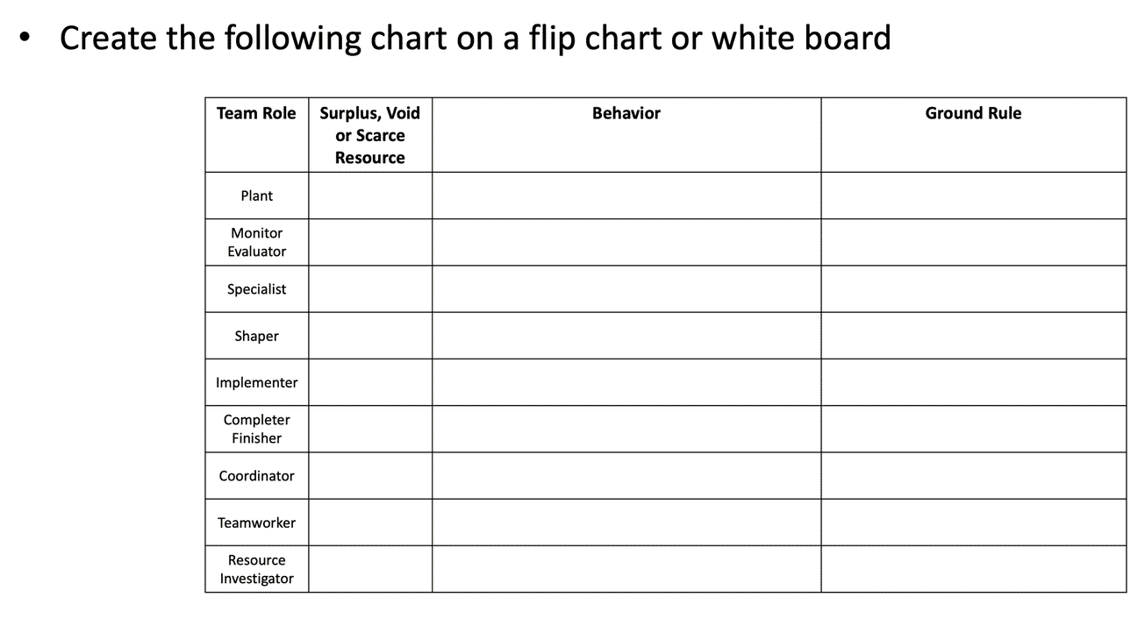
STEP 2: CREATE A CHART TO ANALYZE YOUR
TEAM MAP
belbinnorthamerica.com
Notes:
This chart is the tool we’ll use to make the Team Map actionable.
We’re not analyzing everything at once.
We’ll use this chart to translate patterns on the Team Map into practical adjustments.
The first thing we’ll be looking for are:
Surpluses
Voids
Scarce resources
(We’ll talk about what each of these means next.)
Once we’ve identified those patterns, we’ll explore:
What behaviors we currently see as a result.
What behaviors we might want to adjust, dial up, or dial back.
Finally, we’ll capture a few simple ground rules. These are shared agreements about how the team will work differently. They’re practical, not permanent.
If there is not a surplus void or scarce resource we can skip the team role.

Slide 26
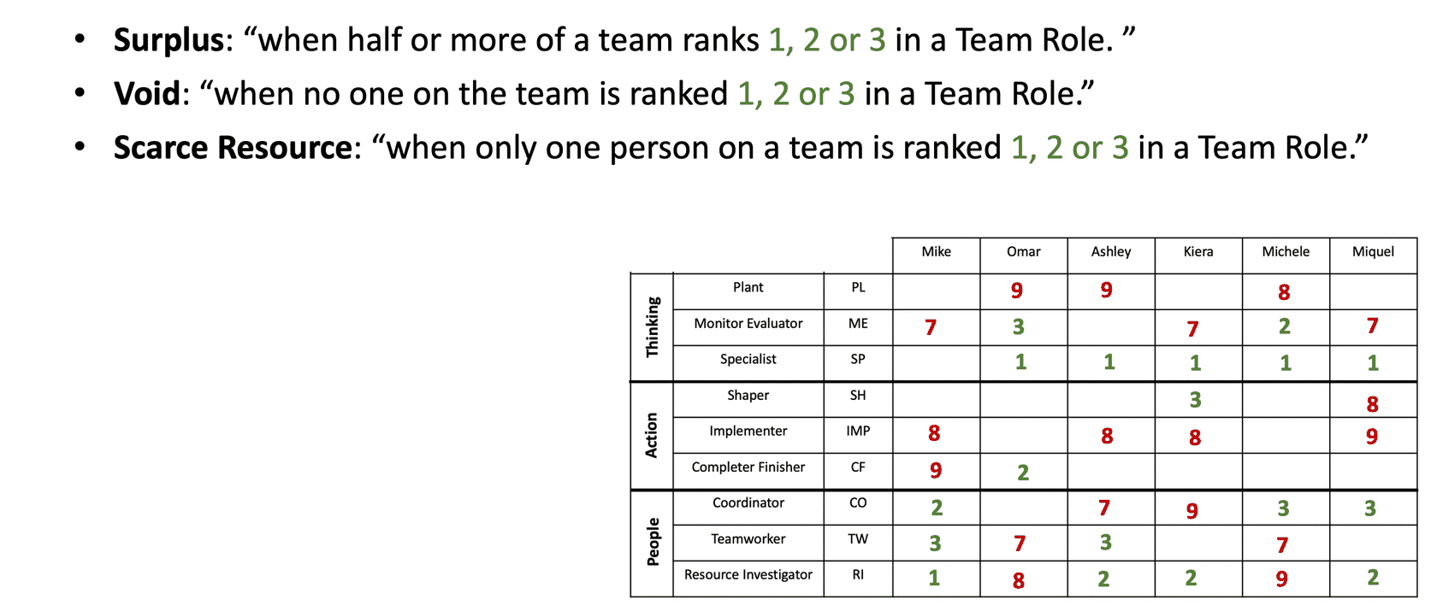
STEP 3: REVIEW SURPLUS, VOID, AND SCARCE RESOURCE DEFINITIONS
belbinnorthamerica.com
Notes:
Review of the three definitions.

Slide 27
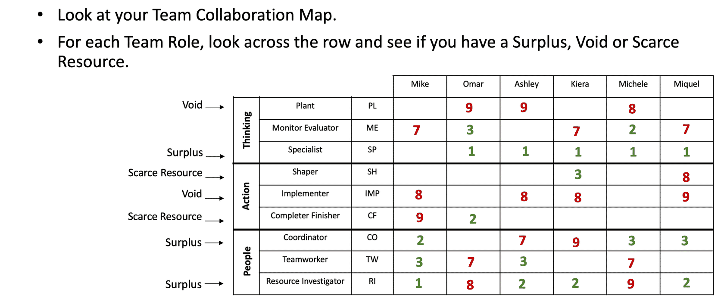
STEP 4: IDENTIFY SURPLUSES, VOIDS, AND SCARCE RESOURCES
belbinnorthamerica.com
Notes:
Identify the voids, surpluses or scarce resources.

Slide 28
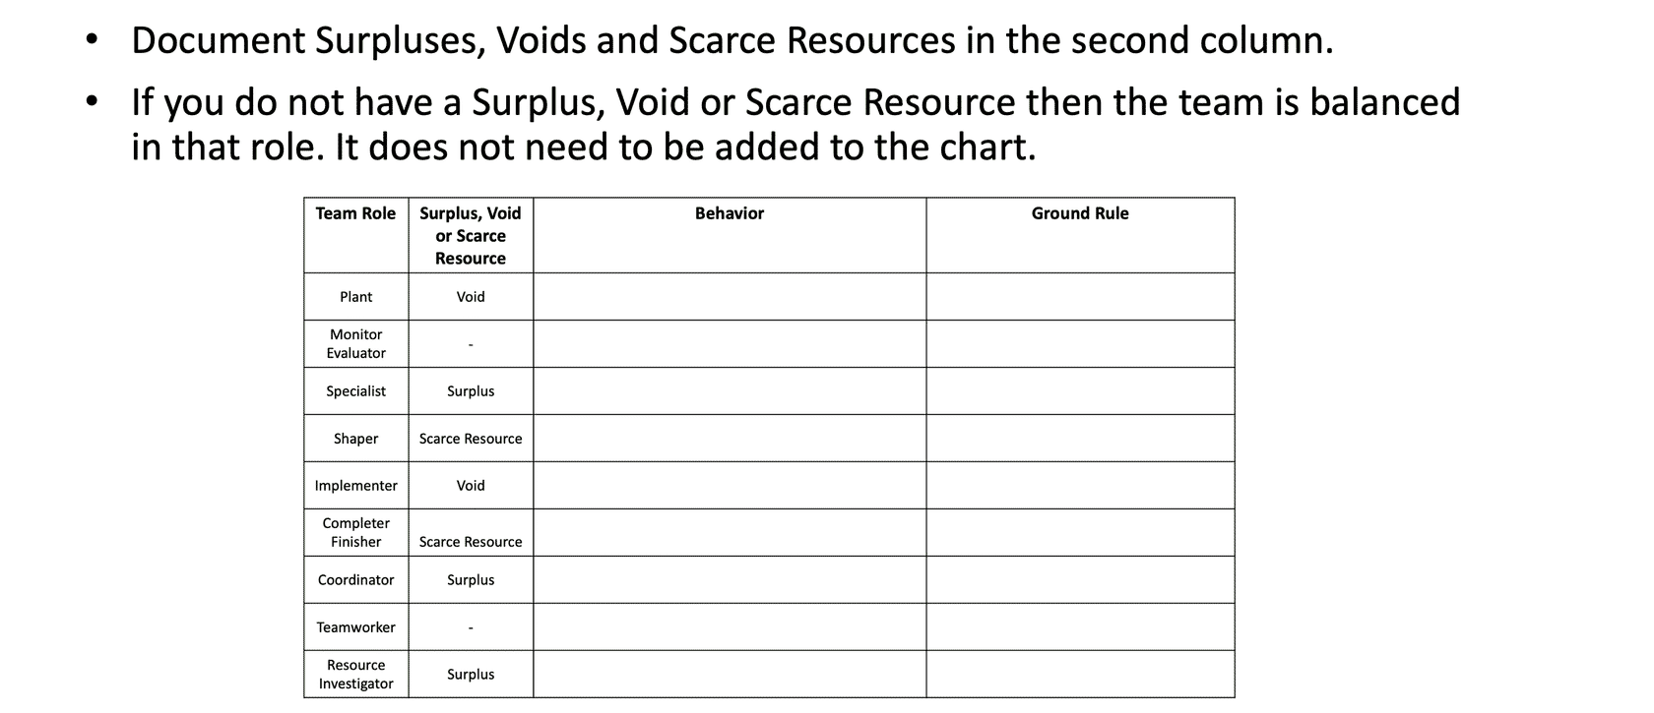
STEP 5: DOCUMENT SURPLUSES, VOIDS, AND SCARCE RESOURCES
belbinnorthamerica.com
Notes:
Chart the voids, surpluses or scarce resources.

Slide 29
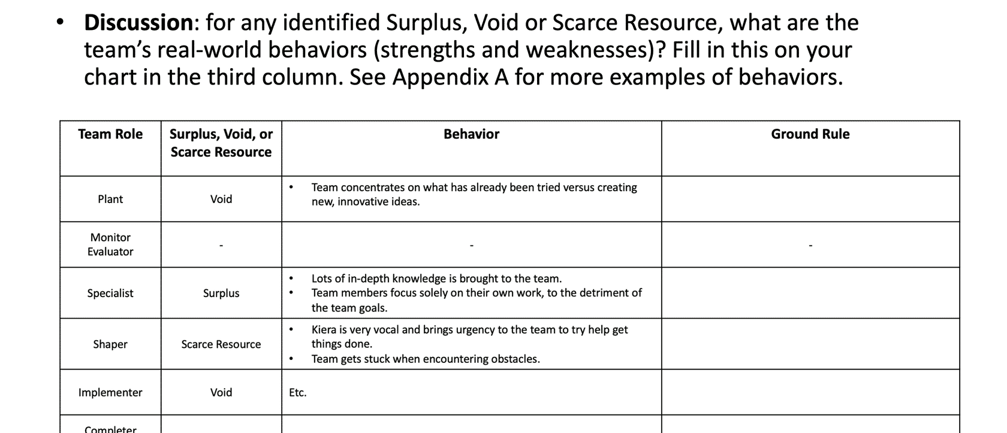
STEP 6: DOCUMENT REAL WORLD BEHAVIORS
belbinnorthamerica.com
Notes:
Document real world behaviors.

Slide 30


CREATE TEAM GROUND RULES
Suggested Time | 45 Minutes

Slide 31

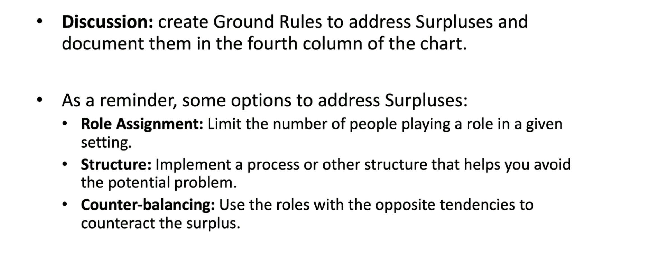
STEP 7: GROUND RULES - SURPLUSES
Options to address Surpluses:
belbinnorthamerica.com
Notes:
Create surplus ground rules.

Slide 32
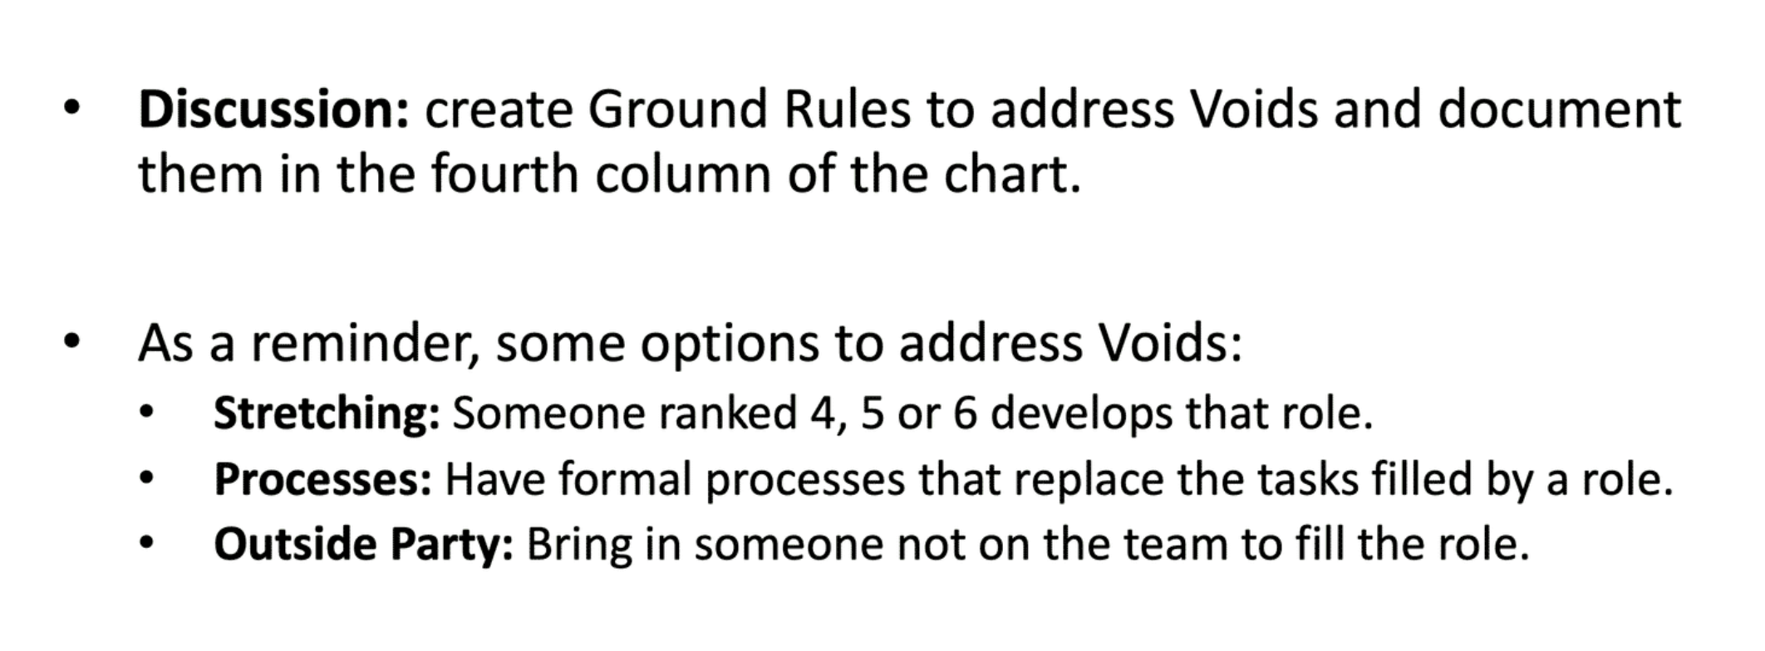
STEP 8: GROUND RULES - VOIDS
Options to address Voids:
belbinnorthamerica.com
Notes:
Create void ground rules.

Slide 33
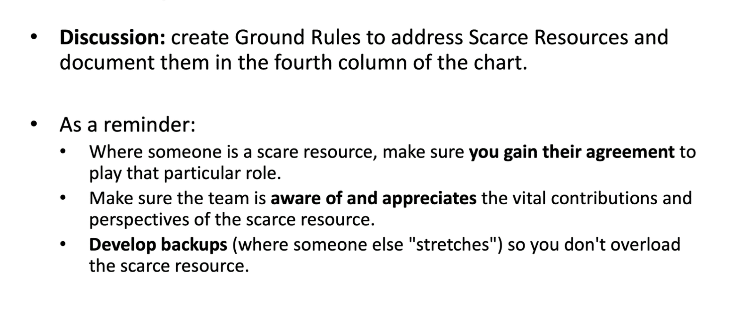
STEP 9: GROUND RULES - SCARCE RESOURCES
Notes regarding Scarce Resources:
belbinnorthamerica.com
Notes:
Create scarce resource ground rules.

Slide 34
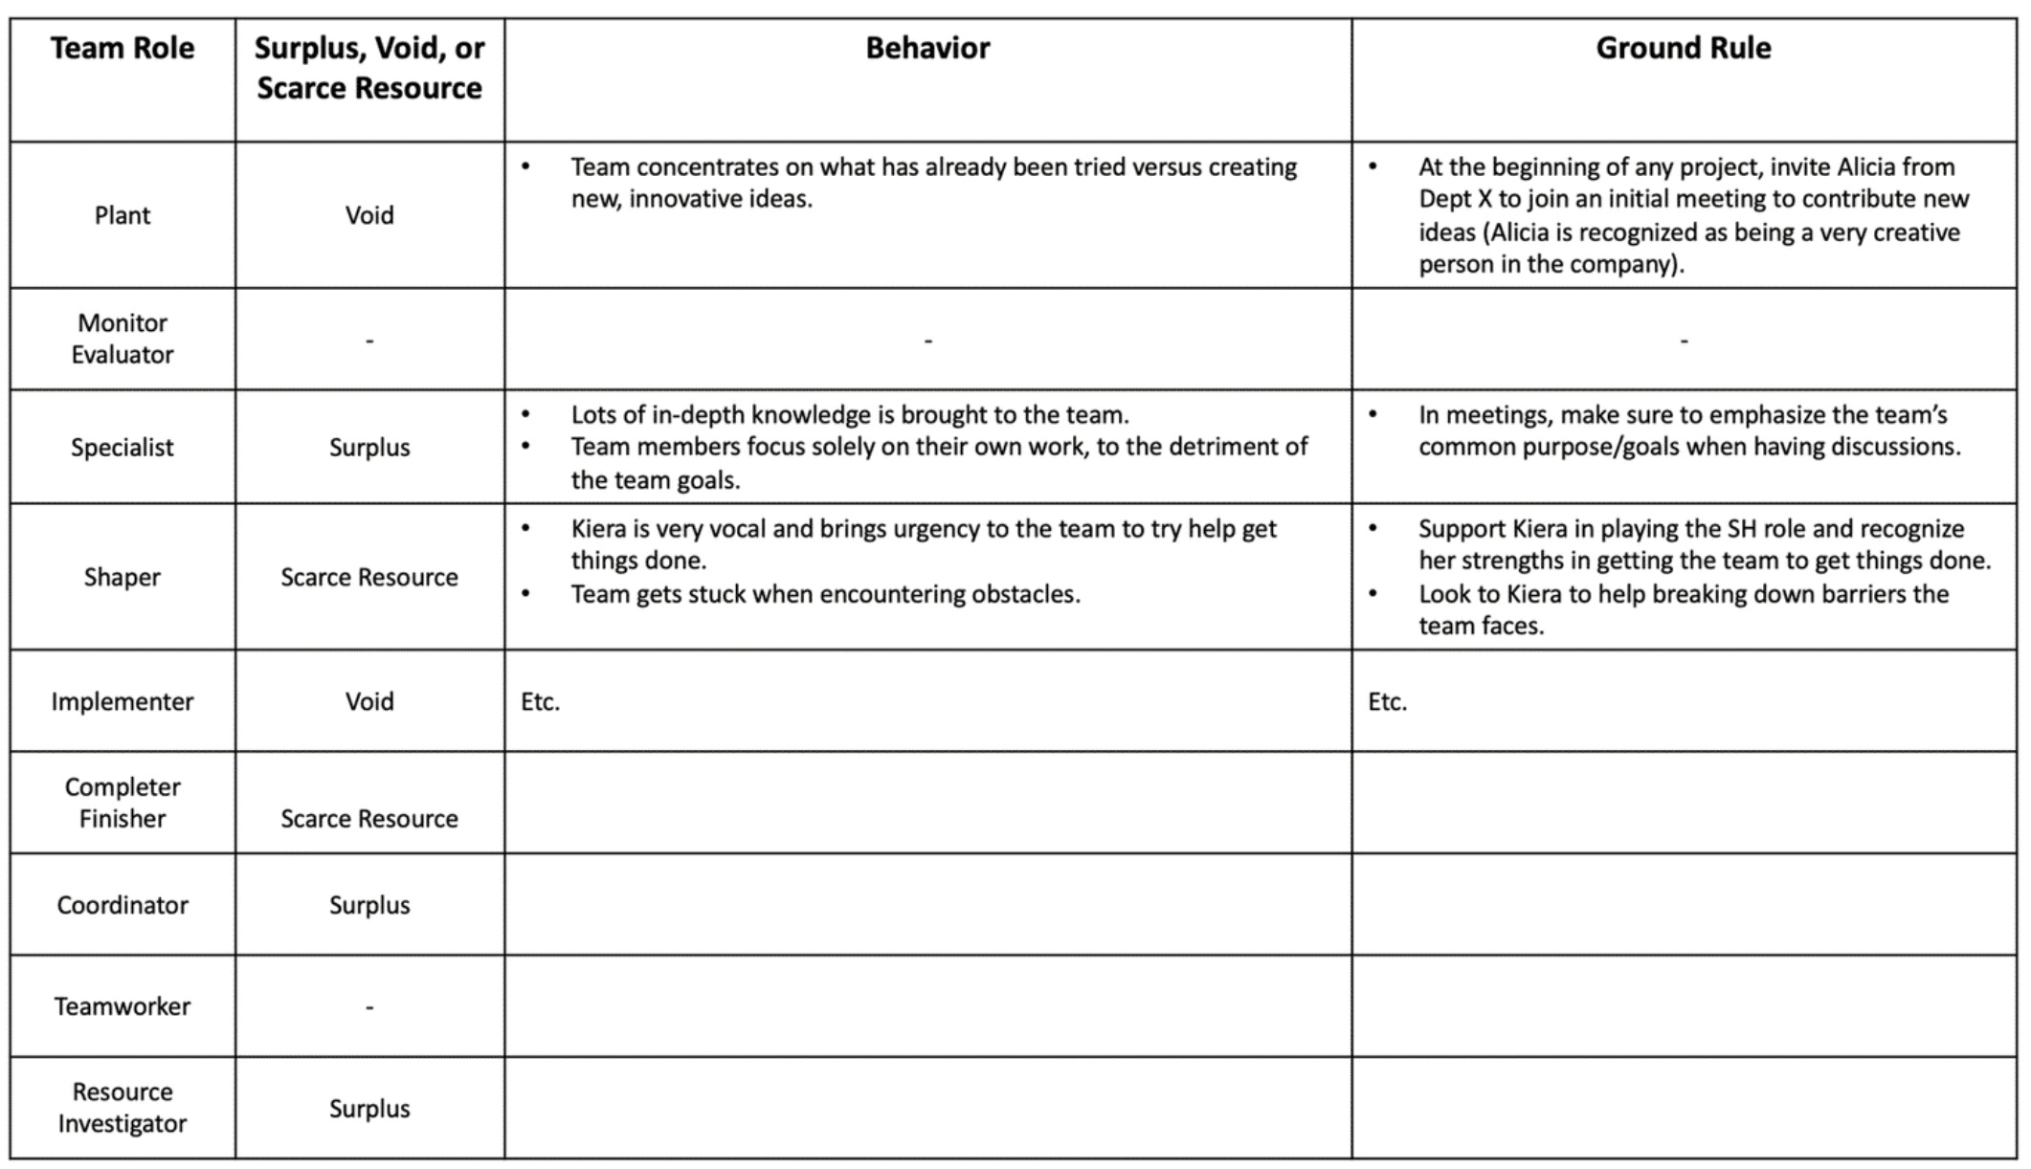
belbinnorthamerica.com
Notes:
Example.

Slide 35

IMPLEMENTATION
Suggested Time | 15 Minutes

Slide 36
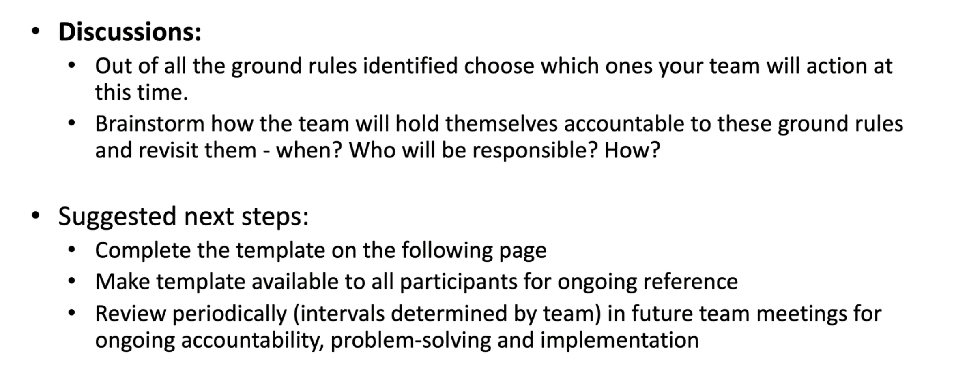
STEP 10: IMPLEMENT SELECTED GROUND RULES
belbinnorthamerica.com
Notes:
Implement ground rules.
Reinforce: How to Use This Going Forward
Belbin works best when it’s used regularly, not stored away.
Simple ways teams often use it:
Referencing roles during project kickoffs
“What roles do we need most for this phase of work?”
Using the Team Map when roles or responsibilities shift
Checking balance during planning or problem-solving meetings
Naming role needs explicitly:
“We need more Monitor Evaluator thinking here.”
Revisiting the map when the team feels stuck or under pressure
The goal is not perfection. It’s shared language and smarter choices over time.

Slide 37
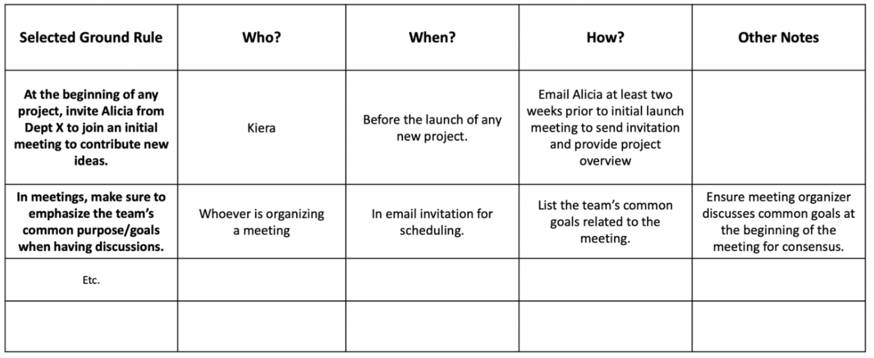
STEP 10: IMPLEMENT SELECTED GROUND RULES
belbinnorthamerica.com
Notes:
Example.

Slide 38
APPENDICES

Slide 39
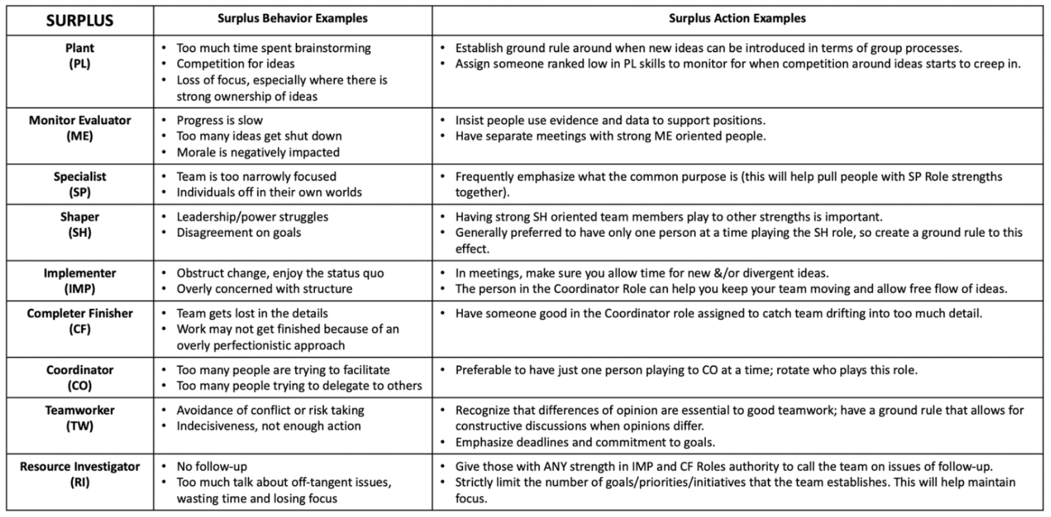
APPENDIX A
belbinnorthamerica.com

Slide 40
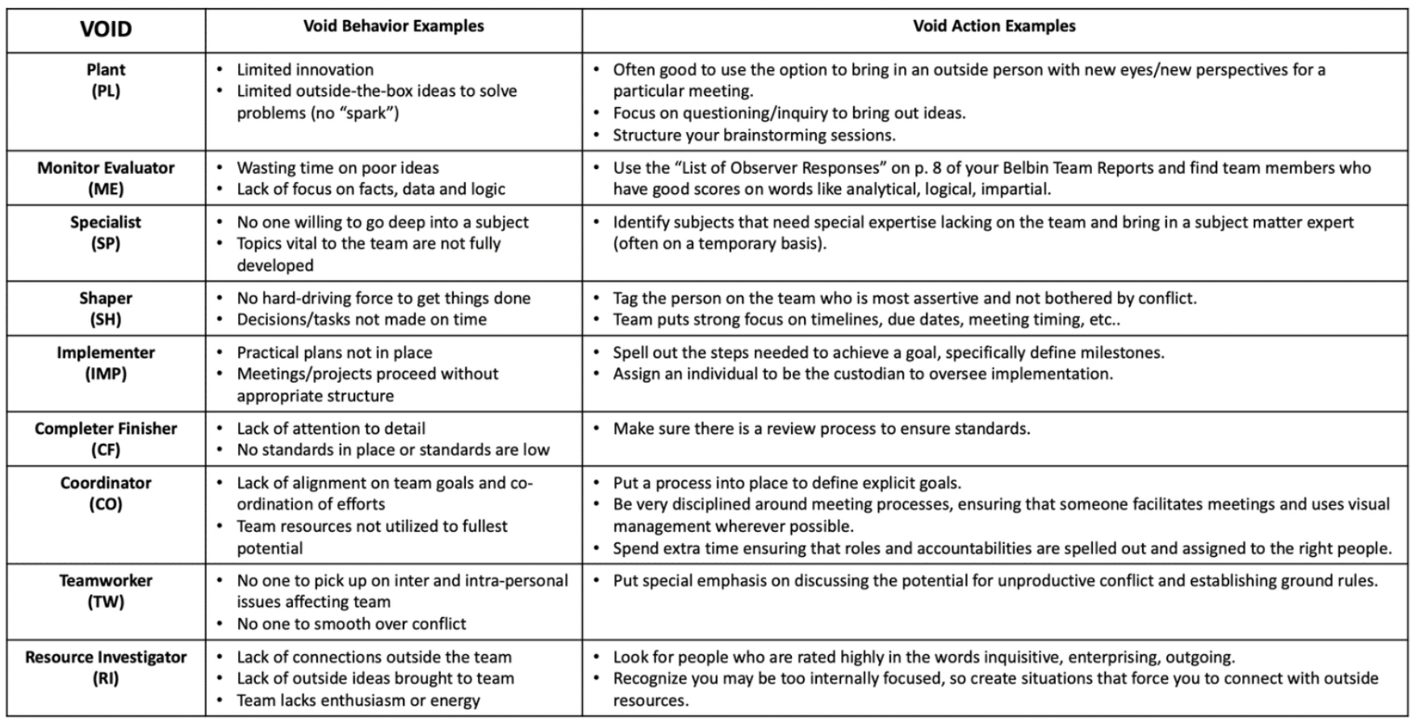
APPENDIX B
belbinnorthamerica.com

Slide 41

GET IN TOUCH
CALL US
937.400.1545 | 877.333.3606
WEB
belbinnorthamerica.com
EMAIL
info@belbinnorthamerica.com
Notes:
As a facilitator, the real value of today isn’t the map itself — it’s how the team uses the language going forward.
You’ve now got a shared way to talk about contribution, gaps, and pressure points without making it personal.
If you notice the team slipping back into old patterns, that’s not failure — that’s your cue to bring the map back into the conversation.
Belbin works best when it’s revisited lightly and regularly, not treated as a one-off.
As we wrap up, the goal isn’t to remember every role or detail. It’s to answer one simple question: “what will you do differently at work tomorrow?”

